Slide 1
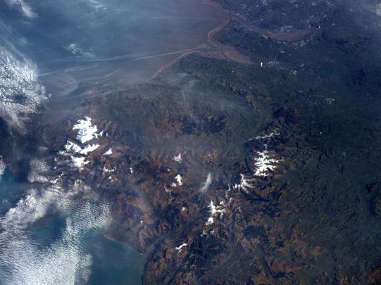
Enhancing your research with public data: an introduction to WORLDCLIM
Heather Robinson
Heather.robinson-2@manchester.ac.uk

Slide 2
Enhancing your own data with public data
Draw in data from other fields
Include data collected under different conditions
Adding data from additional sites or time periods
Increase analytical power
Reducing the financial and time cost of sampling
Testing models/algorithms with independently
collected data

Slide 3
Example data sources
https://www.google.com/publicdata/directory - Google public data
https://archive.ics.uci.edu/ml/datasets.html - machine learning datasets
https://data.gov.uk/ - UK national datasets
http://data.europa.eu/euodp/en/data/ - European datasets
rvest package- web scraping tool
http://www.worldclim.org/version1n -Worldclim climate data
Formats: CSV file, GIS layers, BIL or TIFF files
Notes:
Follow google public data, click GDP global, first record, more information
Data gov UK Click health, then Statistics on Obesity, Physical Activity and Diet, England
EUROP[A CLICK ON CONTRIBUTORS, EUROPEAN PARLIAMENT- see what people think
Click environment, show flooding (GIS) and conservation areas
Open zip-

Slide 4
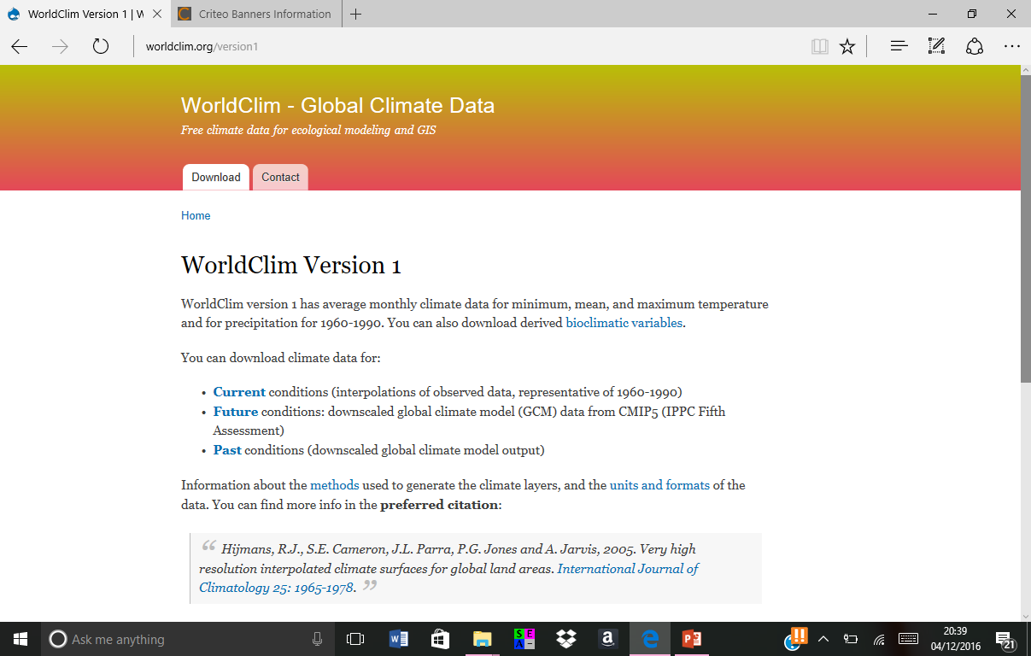

Slide 5
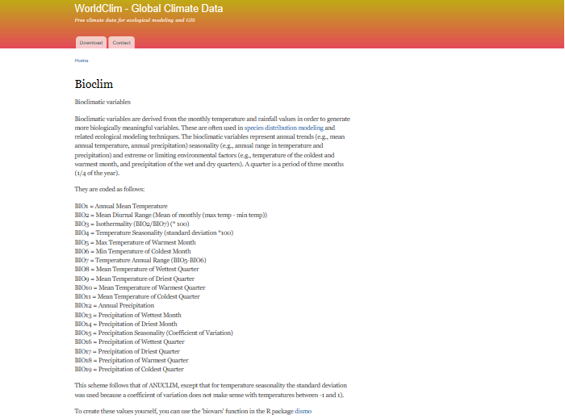

Slide 6
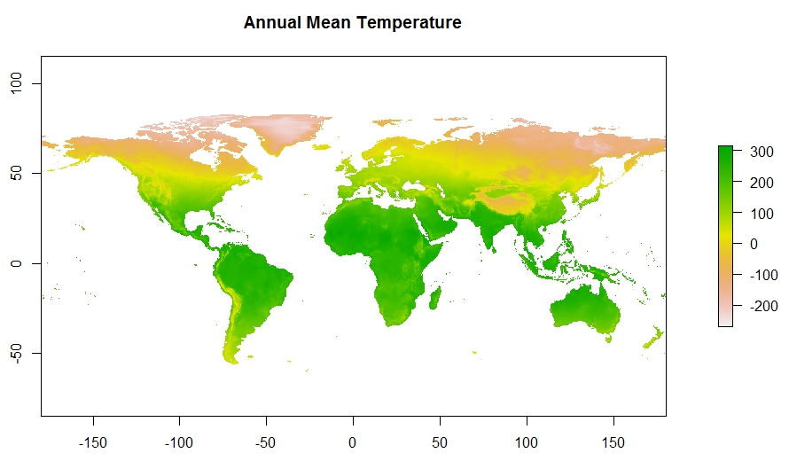
Library(raster)
bioclim<-getData('worldclim', var='bio', res=2.5)
plot(bioclim$bio1, main="Annual Mean Temperature")
Notes:
GetData will also call data from the Shuttle Radar Tomography map or plot country boundaries

Slide 7
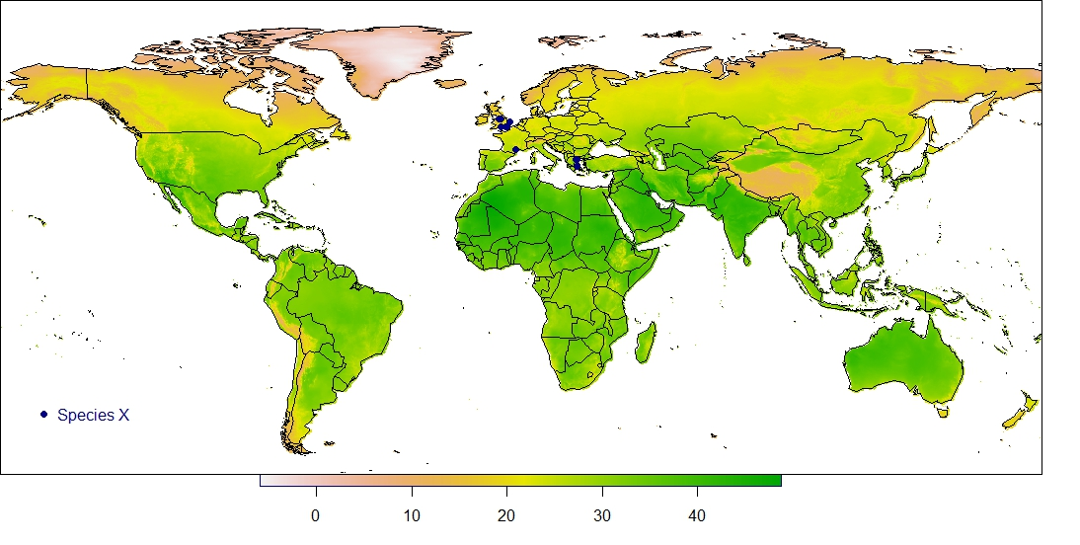
Using BIOCLIM layers as map layers
plot((bioclim$bio5/10),xaxt='n',horizontal=TRUE,xlim=c(-170,180),ylim=c(-55,85))
map(xlim=c(-170,180),ylim=c(-65,85),add=T)
par(xpd=TRUE)
for (s in unique(site[Spar==1])) {points(mean(longitude[site==s]),mean(latitude[site==s]),bg="navy")}
legend(-160,-30, "Species X",col=c("navy"),pch=16,title="",bty="n")

Slide 8
Example research question
https://www.ncbi.nlm.nih.gov/pmc/articles/PMC4761769/
Species X is uncommon in the UK but more common in the Mediterranean
Hypothesis: habitat is limited by temperature
Use BIOCLIM to extract maximum annual temperature values for each sampling location
Run regression analysis including temperature as a factor

Slide 9
Extracting BIOCLIM values using coordinates
bioclim<-getData('worldclim', var='bio', res=2.5))
climdata<-file(paste("climdata.txt"), open="w")cat("hostName","latitude","longitude","Xannualtemp","xdiurnalrange","isothermality","tempseasonality","maxtemp","mincoldtemp","xtemprange","xtempwetquart","xtempdryquart","xtemphotquart","xtempcoldquart","xprec","precwetmonth","precdrymonth","precseasonality","\n", file="climdata.txt", sep="\t", append=TRUE)
l=sampledata$longitude
a=sampledata$latitude
for (n in 1:166){c<-c(l[n],l[n]+0.01,a[n],a[n]+0.01)
e<-extent(c)
zoom<-crop(bioclim, e)
cat((paste(sampledata$hostName[n])),ymin(zoom),xmin(zoom),minValue(zoom$bio1),minValue(zoom$bio2),minValue(zoom$bio3),minValue(zoom$bio4),minValue(zoom$bio5), minValue(zoom$bio6), minValue(zoom$bio7), minValue(zoom$bio8), minValue(zoom$bio9), minValue(zoom$bio10), minValue(zoom$bio11), minValue(zoom$bio12), minValue(zoom$bio13), minValue(zoom$bio14), minValue(zoom$bio15), "\n", file="climdata.txt", sep="\t", fill=FALSE, labels=NULL, append=TRUE)}
climdata<-read.table("climdata.txt", header=TRUE)
joined<-merge(sampledata,climdata, by="hostName")

Slide 10
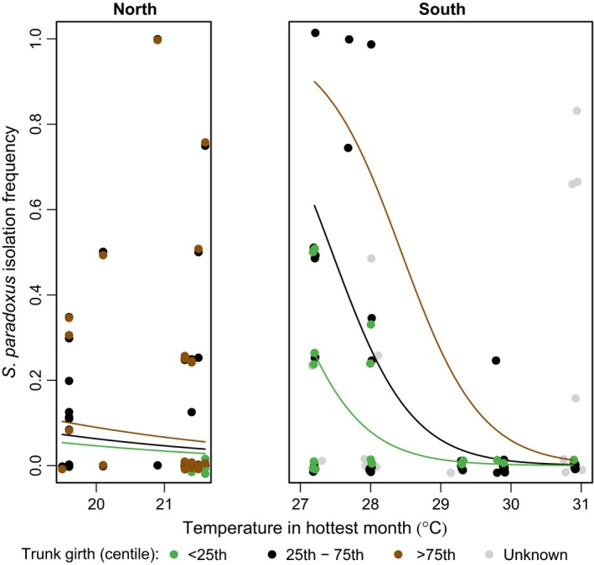

Slide 11
Plotting parameter ranges
e2<-extent(-12,90,20,80)
zoom<-crop(raster(‘bio5.bil’), e2)
par(mar=c(0,0,0,2))
breakpoints <- c(18,22,28,31)
colors <- c("gray85","gray50","gray70")
plot((zoom$bio5/10),breaks=breakpoints,col=colors,xaxt='n',yaxt='n',,horizontal=TRUE,xlim=c(-170,180),ylim=c(-55,85))
map(xlim=c(-10,32),ylim=c(35,65),add=T)
par(xpd=TRUE)
legend(-4,18,legend=expression(paste("Temp (",degree,"C)")),col="white",title="",bty="n")
longitude<-as.numeric(as.character(longitude))
par(pch=21, col="black")
# POINTS FOR PRESENT
for (s in unique(site[Spar==1])) {points(mean(longitude[site==s]),mean(latitude[site==s]),bg=“yellow”)}
legend(-160,-30, "S. paradoxus",col="yellow",pch=19,title="",bty="n")

Slide 12
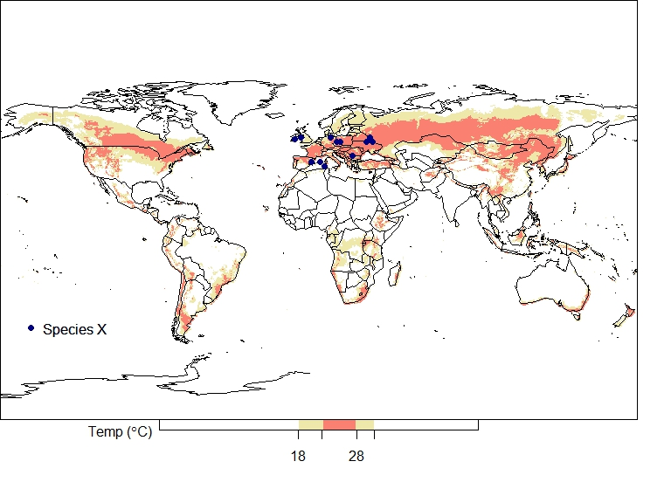

Slide 13
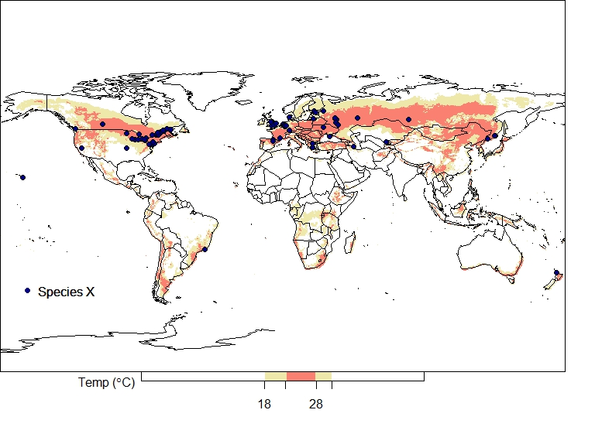

Slide 14
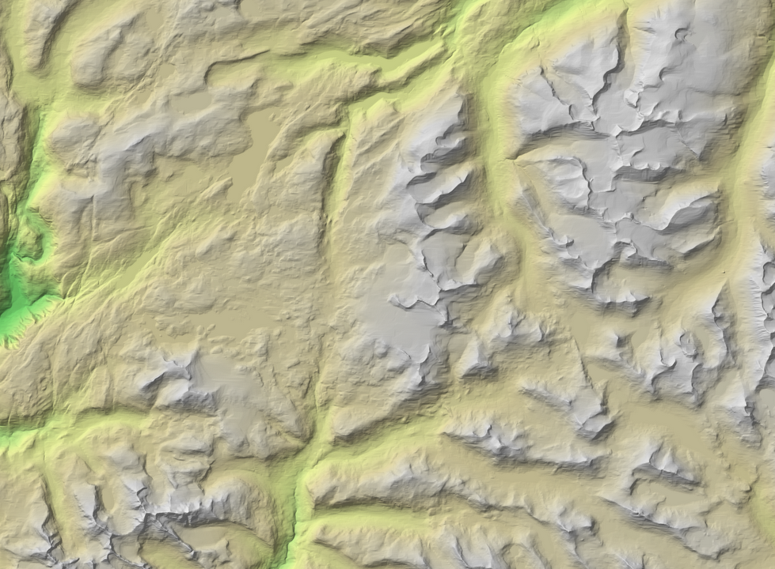
Links
onlinelibrary.wiley.com/doi/10.1002/ece3.1919/full
http://github.com/RUMgroup
www.worldclim.org
https://www.r-bloggers.com

